Slide 1
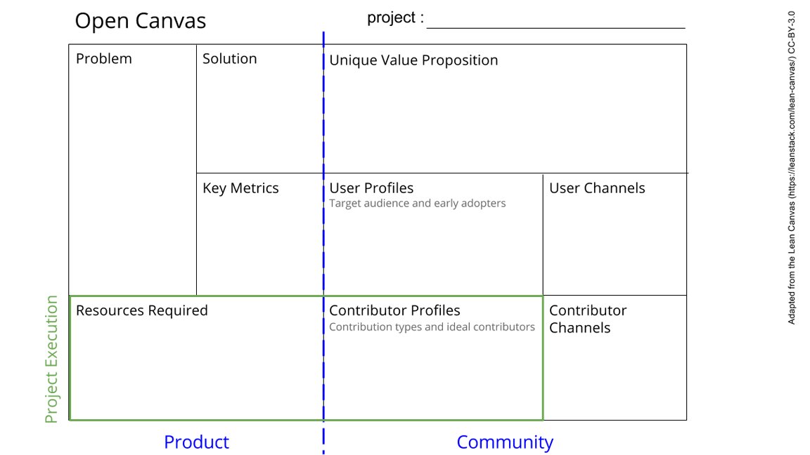
Caribou habitat conservation
Limited understanding of caribou habitat dynamics in the Slate Islands Provincial Park and its anticipated evolution.
Habitat knowledge is often conveyed using scientific jargon and remote sensing terminologies, making it less accessible.
Weak connection between Indigenous knowledge and scientific observations.
Estimate the Caribou food resources and status of the Slate islands
Provide a habitat change models through indigenous insight
Habitat change model map accessible and understandable to both indigenous people and scientists for caribou conservation
The percentage of the Indigenous people contacted capable of interpreting the designed habitat change map
Scoping the project to involve more parties using social media (more diverse channels requisite for communication)
The Biigtigong First nation
Scientists
Landsat from 1984 -2024
Open software packages including R and QGIS
Chief and Council of Indigenous communities
Interviews with First nation
Remote Sensing Images
Field data on Caribou food resources
Sharing research information to research organisations and interest groups
bodies to involve in challenges resolution
Notes:
Go to File > Make a Copy… to make your own canvas
See next slide for instructions

